Slide 1
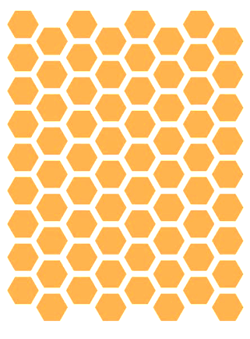
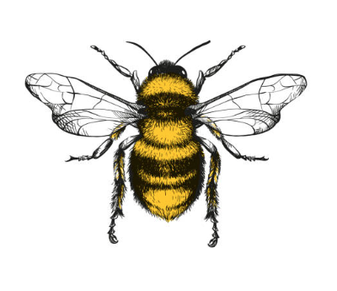
Bee Colonies: What’s the Recent Buzz?
zzzz
zzz

Slide 2
History of Honey Bee Losses
A timeline of the landslide in colony losses
Over 50% reduction in number of colonies in the U.S. from the 1940’s
1947
1987
2021
1940’s
Introduction of DDT & other harmful pesticides
Introduction of Invasive Varroa Mites + other pathogens
2.8 million
6 million
1970
# of Small Farms After WW2
Habitat Loss & Global Warming
3 million
Notes:
Dipping to a low of ~ 2.3 million in 2006 before making some recovery
Sources:
https://www.ars.usda.gov/oc/br/ccd/index/#history
https://www.intechopen.com/chapters/50073

Slide 3
A Mystery Plague: Colony Collapse Disorder (CCD)
First characterized in 2006, beekeepers reported as much as 30-90% loss of their hives
Signs of CCD:
Sudden vanishing/loss of a colony’s worker bee population
Little to no dead bees
Queen and young brood remain
Abundant honey and pollen reserves remain
Without worker bees, the hives eventually die off
Despite intense research, no definitive underlying cause has been identified for CCD
Suspected causes:
Parasites
Diseases
Pesticides
Loss of habitat
Poor nutrition
Notes:
Source:
https://www.epa.gov/pollinator-protection/colony-collapse-disorder#:~:text=Pesticide%20poisoning%20through%20exposure%20to,the%20habitat%20where%20bees%20forage.

Slide 4
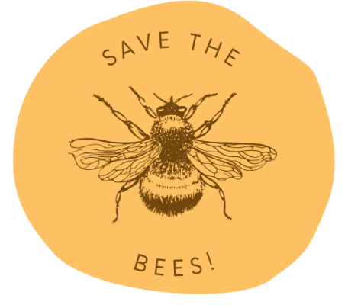
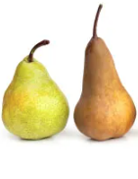
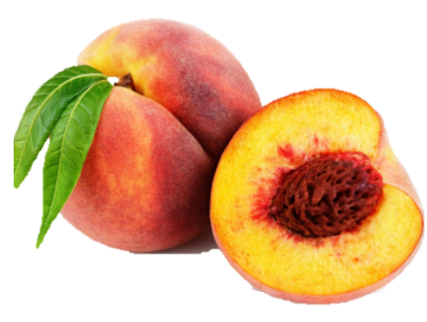


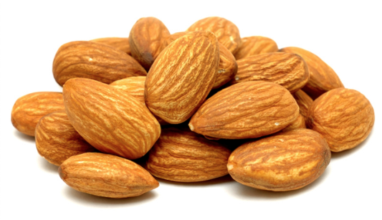

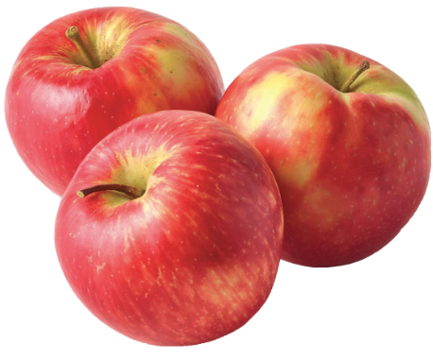

Save The Bees
The bee die off has been termed the Bee-pocalypse or Beemageddon
Bee colony loss poses a threat to food security
Bee pollination enables the production of 90+ commercially
grown crops in North America
Their combined services of bees in the U.S. alone are worth greater than
15 billion dollars
Image Source: https://shorebags.com/blogs/news/were-honoring-the-disappearing-honey-bee
Notes:
Source: https://www.washingtonpost.com/news/wonk/wp/2015/07/23/call-off-the-bee-pocalypse-u-s-honeybee-colonies-hit-a-20-year-high/

Slide 5
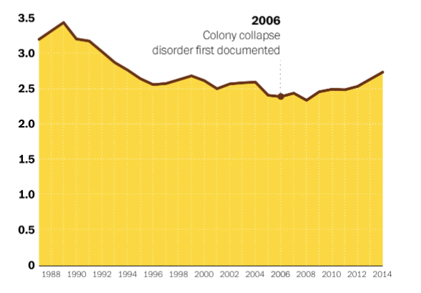
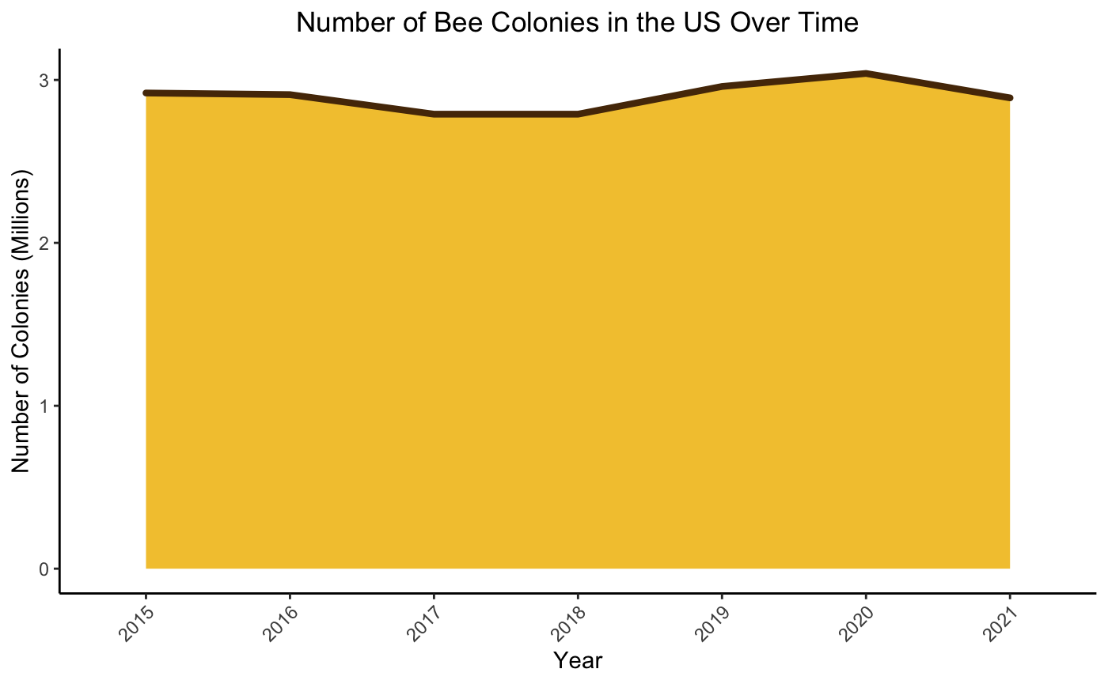
How Have the Bees Been Doing?
Colony Collapse Disorder (CCD) first characterized
2006
Stable populations in recent years
Source: USDA Honey Production Surveys

Slide 6
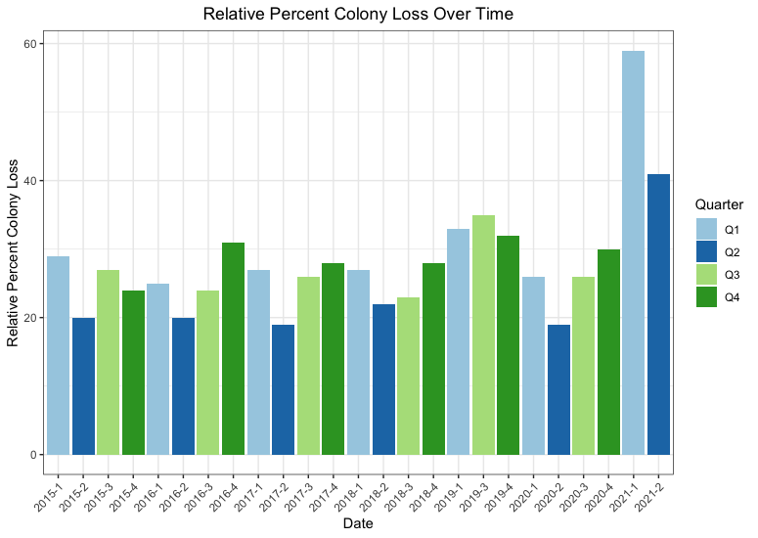
Is There a Pattern in Colony Loss Across the US?
Notes:
https://cmr.berkeley.edu/2016/10/colony-collapse-disorder/

Slide 7
Colony loss across the US appears to have a cyclical nature
Greater number of colony losses observed in the colder months (Q4 & Q1)
Colony loss is consistently lowest in the spring months (Q2) when nectar and pollen are most readily available

Slide 8
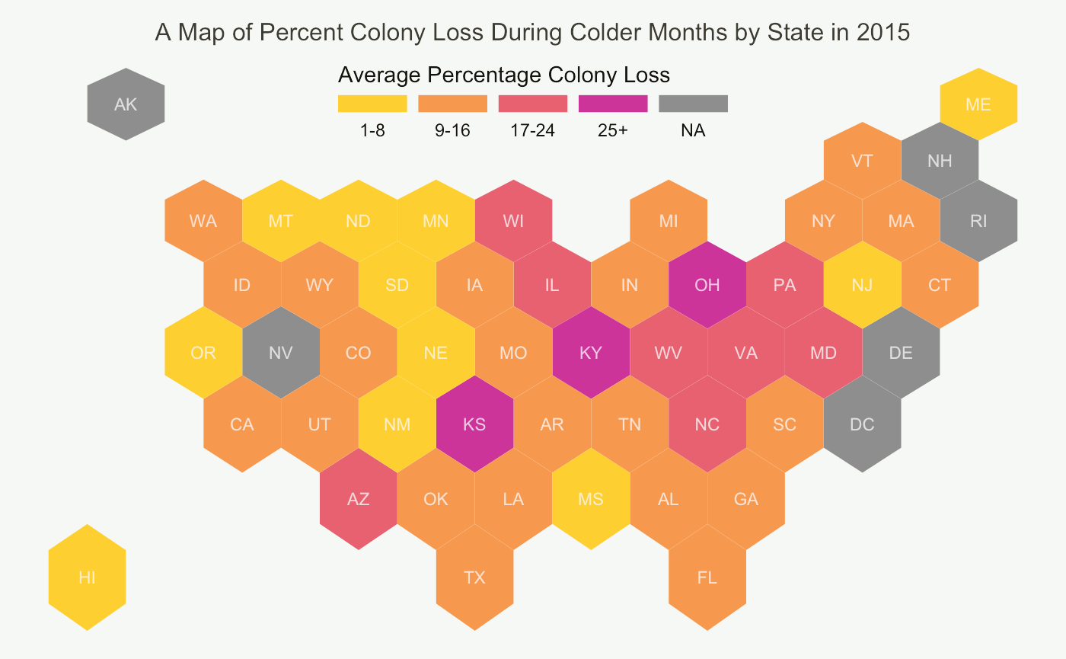
Are Bees Dying Everywhere?

Slide 9
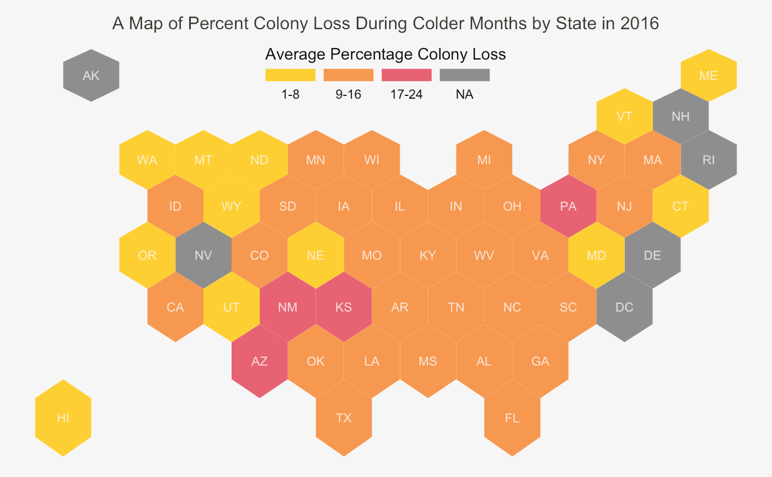

Slide 10
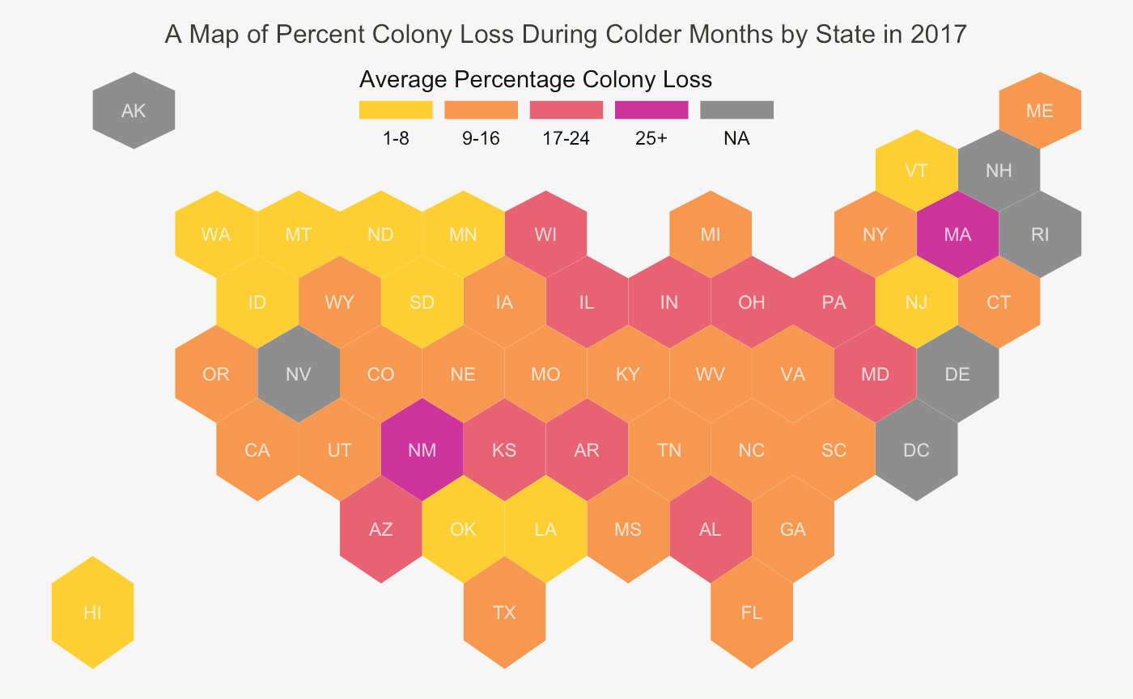

Slide 11
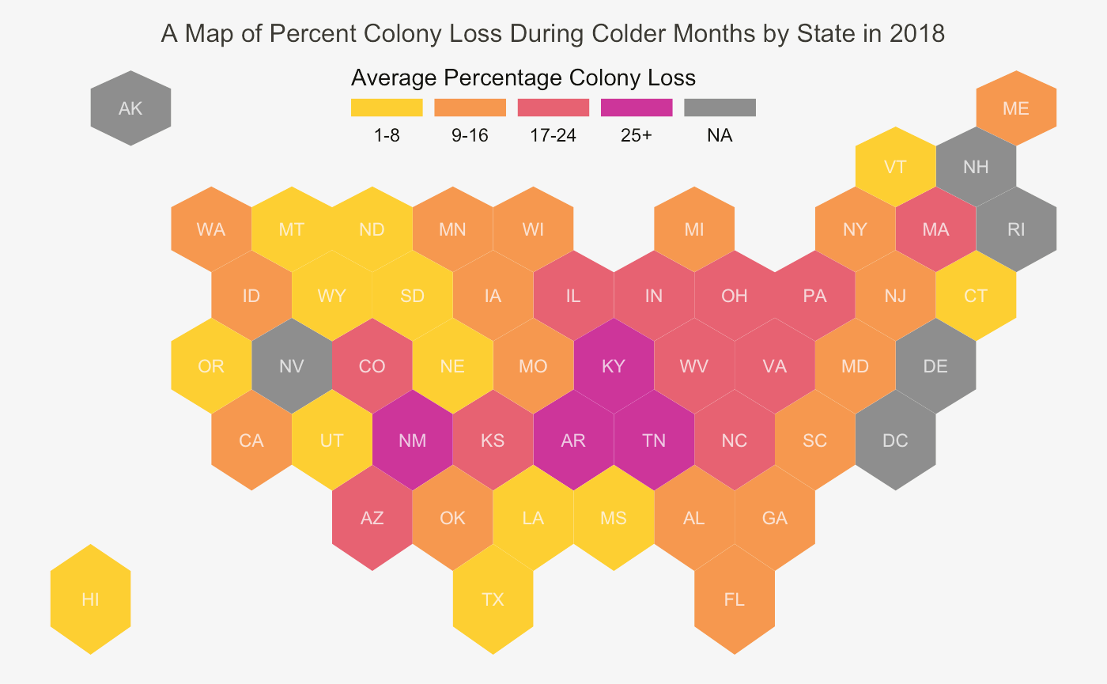

Slide 12
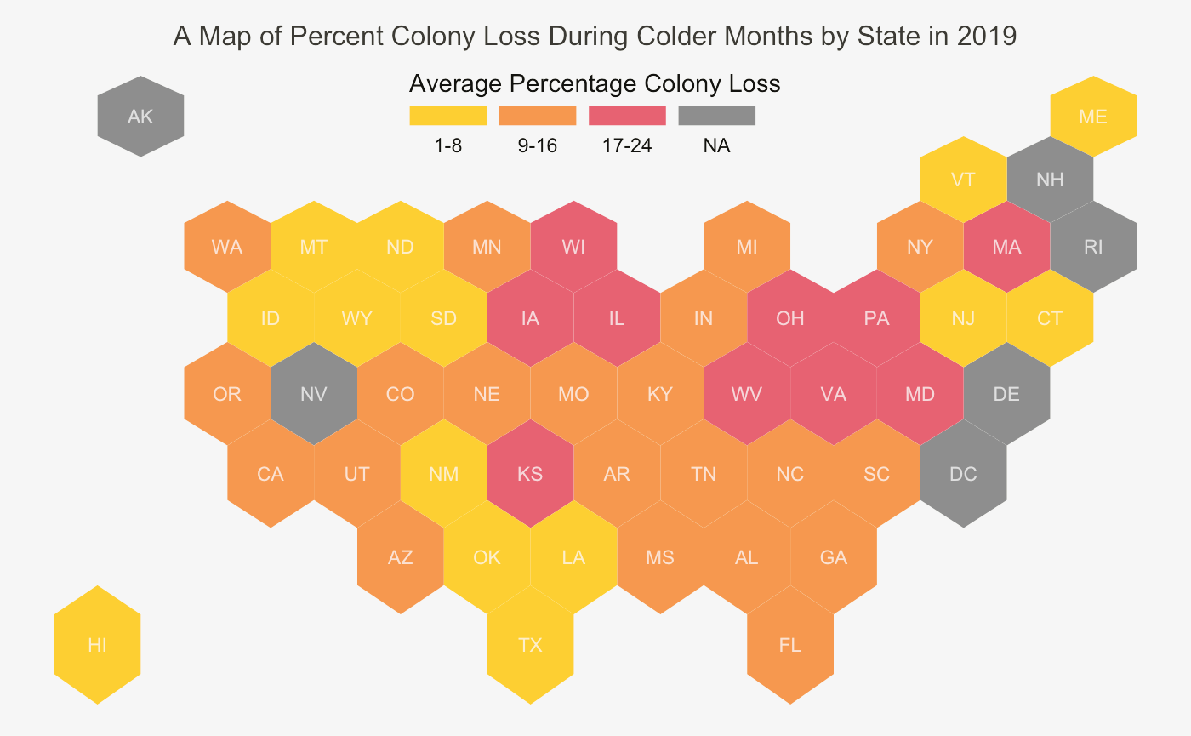

Slide 13
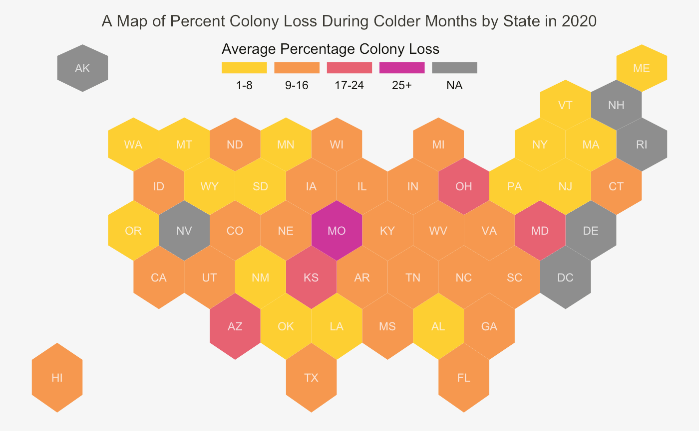

Slide 14
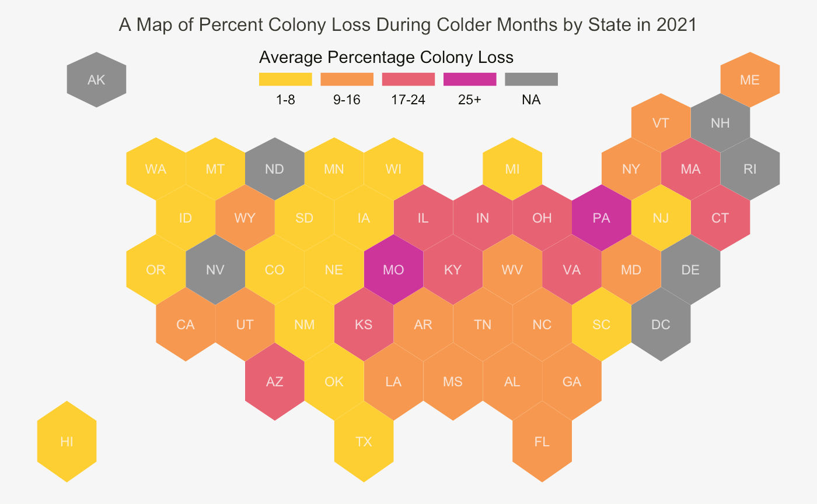

Slide 15

Data Sources
Don’t worry, bee happy
Bee Colony Data: https://www.kaggle.com/datasets/kyleahmurphy/nass-honey-bee-20152021
Temperature Data: https://www.ncdc.noaa.gov/cag/statewide/time-series/50/tavg/12/4/2015-2022?base_prd=true&begbaseyear=1901&endbaseyear=2000&fbclid=IwAR0agv7-tZQdluJpUc8ErGi8QVyq2BC0VAtW25E6oVks0vIRMp8GjgPVNYY

